Slide 1
Crop-pollinator interactions: a meta-analysis
Paul Sabin, Code Academy Berlin
16 February 2024

Slide 2
Contents
01
02
03
Introduction
Finding Data
EDA
04
05
06
ML Results
Challenges
Key Takeaways

Slide 3
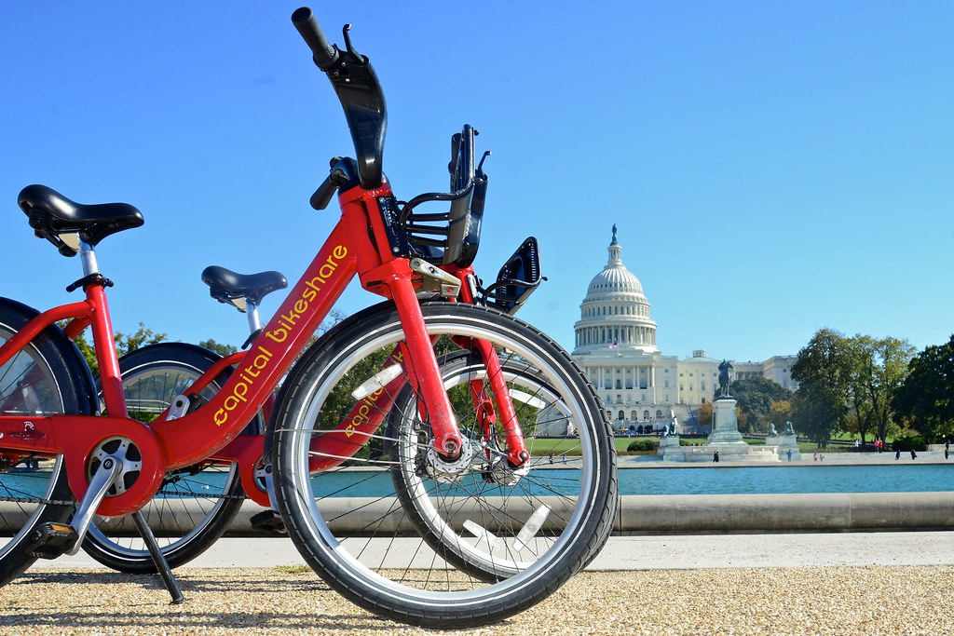
01
Introduction

Slide 4
Introducing the client
xxx
xxx
xxx
xxx
xxx
13

Slide 5
What role do pollinators play?
xxx
xxx
xxx
5
Notes:
“Pollination, a critical and sensitive ecological process, involves the transfer of pollen from the male to the female reproductive organs of plants, a vital step for fertilization and seed production. While some species are wind-pollinated, a significant number of plants, especially in agricultural contexts, depend heavily on animal pollinators, such as bees and other insects and animals.”
“Declining bee populations: Bees are paramount for the pollination of many crops. Nevertheless, their numbers are dwindling globally due to factors like pesticide use, habitat loss, diseases, and climate change. This decline hampers pollination efficiency, leading to lower crop yields and poorer quality which poses a risk to food security and challenges farmer´s competitiveness. ”

Slide 6

Defining the task: a meta-analysis
Research papers
Data collection
Comparison
Learnings
4
Notes:
My client wanted to know:
What research exists on pollinators & crop interaction?
How do the respective researchers observe and record data in the field?
Can we gain some insights by analysing data from multiple studies?
How can these findings inform the client’s own future research?

Slide 7
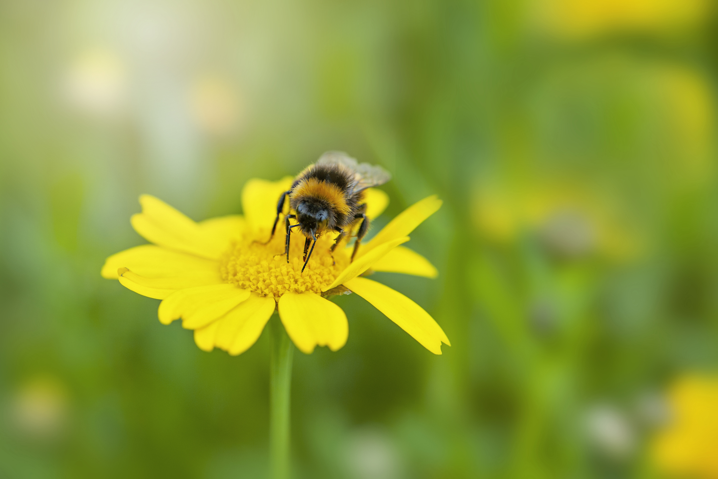
02
Finding Data

Slide 8
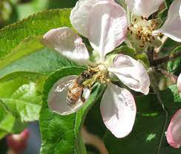
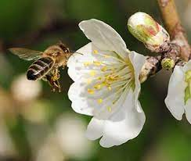
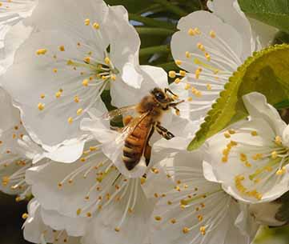
Criteria for studies to include
Apple
Almond
Cherry
Growing locations in Europe
Data collected since 2010
Measure of crop success
5
Notes:
Three crops were specified by the client
I decided to narrow my search to European locations in order to limit the amount of variation in terms of plant varieties, insect species and weather systems.
Although field data was available going back almost a century in some cases, I looked for data collected since 2010 to ensure capture a recent state of biodiversity and greater similarity of farming practices.
A common theme from numerous studies was to look at the affect of different factors on the success of the crops. This was commonly measured as “fruit set”, which means the percentage of flowers that start to develop into fruits after successful pollination, or yield, which is the weight of fruit that is later harvested.

Slide 9
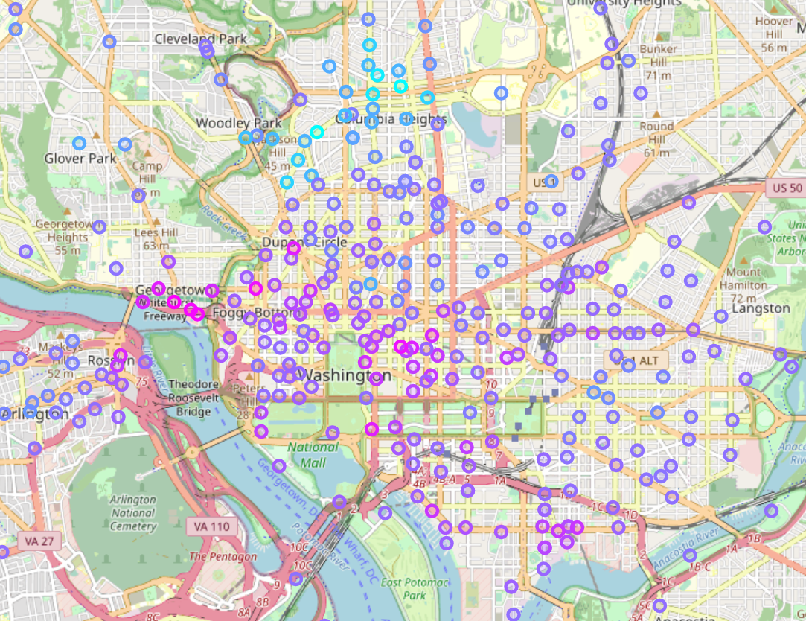
Losing bikes
Balanced
Gaining bikes
4
Notes:
Here’s a screenshot of a map similar to the one I created for my EDA. Each circle represents a station, and the colour is mapped to the ratio of bikes added, so light blue circles are stations that lose a lot of bikes and are in danger of becoming empty, darker blue/purple circles are well balanced stations, which are the majority, and bright pink circles are stations that gain a lot of bikes and therefore often get full up and “dockblock” riders.
The ML models can’t see the map or the features of Washington DC, but can they nevertheless extract useful information from the latitude and longitude data?

Slide 10
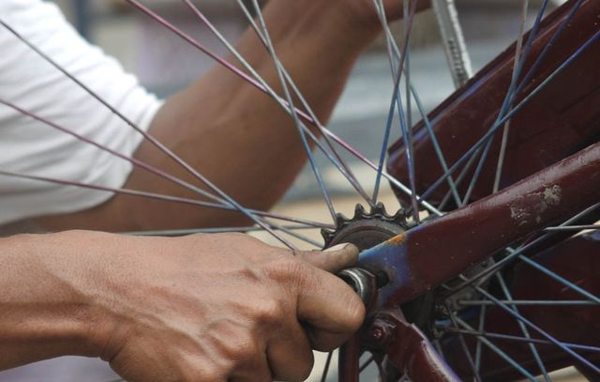
03
Exploratory Data Analysis

Slide 11
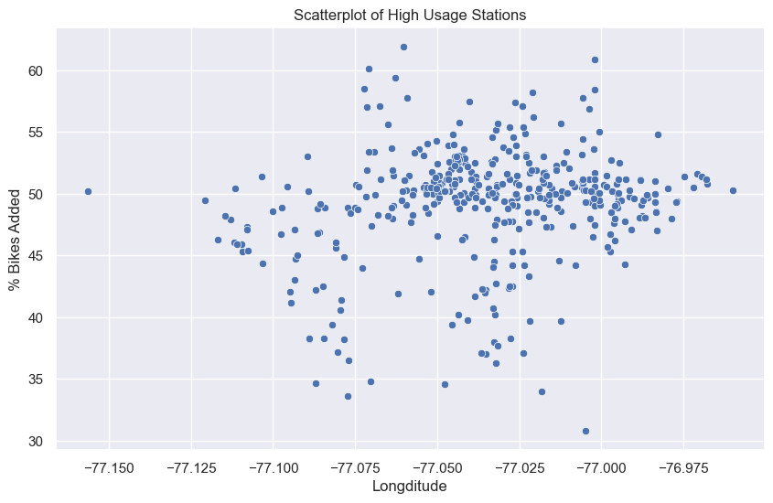
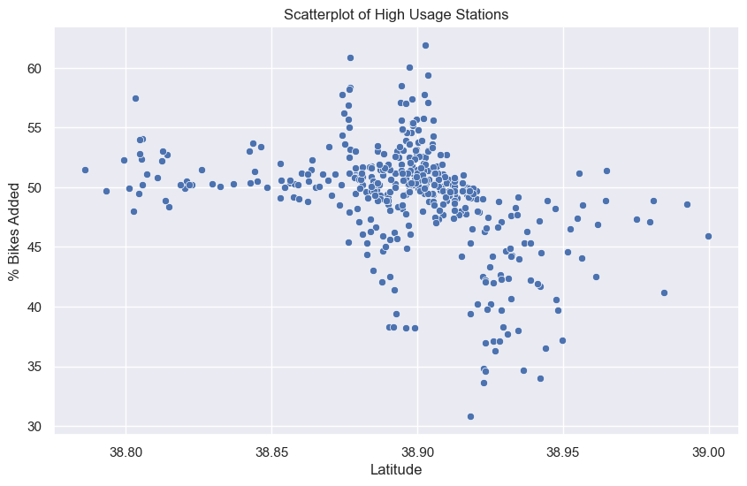
Looking for correlation
6
Notes:
So first of all I just wanted to see whether any correlation would be visible to the naked eye by plotting on these two graphs longitude versus ratio of bikes added, and the same with latitude. As you can see, there does appear to be some pattern here, so I decided it was worth exploring this topic further. However, it would be difficult to express the patterns you see here as a line, a curve or even a number of curves. So I was unsure how far I would get with linear regression or polynomial regression methods.

Slide 12
Steps…
Trained 10 models with lat/long as input variables
Attempted to predict ratio of bikes added, net total
Trimmed data set to omit least used stations
Focused on most promising models
Performed hyperparameter tuning
13

Slide 13

04
ML Results

Slide 14
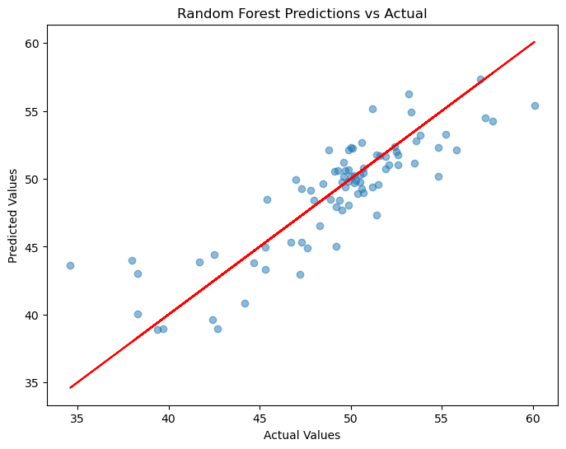
Predicting ratio of bikes added
Random Forest:
Mean Absolute Error: 1.83
Mean Squared Error: 5.78
Root Mean Squared Error: 2.40
R-squared: 0.73
6
Notes:
Ratio of bikes added is a measure of how balanced a specific station is. 50/50 = perfectly balanced. <50 = losing bikes. >50 gaining bikes.
Each dot represents a station. Many stations are clustered around the 50 mark. Lowest ratio around 35, highest around 60 – very problematic stations that require a lot of rebalancing.
The model correctly identifies stations that are balanced, those that lose bikes and those that gain bikes almost every time. However, it is not very accurate when it comes to the degree of imbalance. For stations that are extremely unbalanced, the model often gives a more conservative estimate.

Slide 15
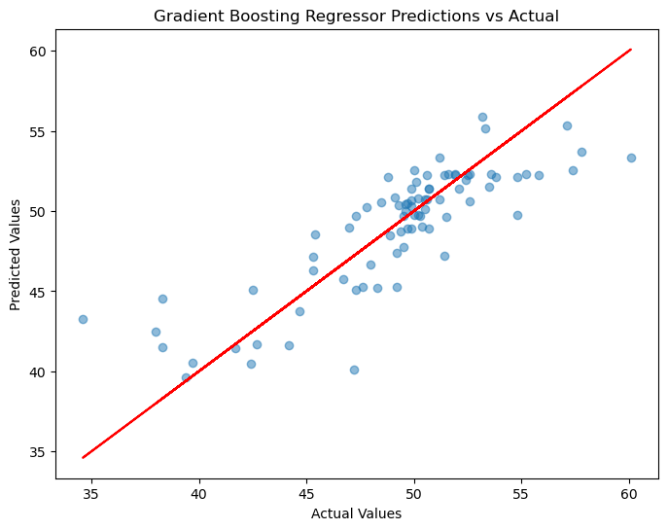
Predicting ratio of bikes added
Gradient Boosting Regressor:
Mean Absolute Error: 1.89
Mean Squared Error: 6.44
Root Mean Squared Error: 2.54
R-squared: 0.70
6
Notes:
Gradient boosting regressor performs similarly well to the random forest. You can see that the dots reveal a trend that aligns, to some extent, with the diagonal line of perfect predictions. Again, the more extreme actual values tend to have a larger error. My intuition here is that both these models are doing a good job of identifying patches, within the coordinates data, where stations are very likely to gain or lose bikes. However, the prediction is then based on a mean value for that geographical area. That’s why we see a horizontal arrangement of the blue dots on this plot: the models are making very similar guesses for groups of stations. The stations with more extreme actual ratios are likely influenced by additional factors that are not being taken into account at all by these models, which have been trained exclusively on positional data.

Slide 16
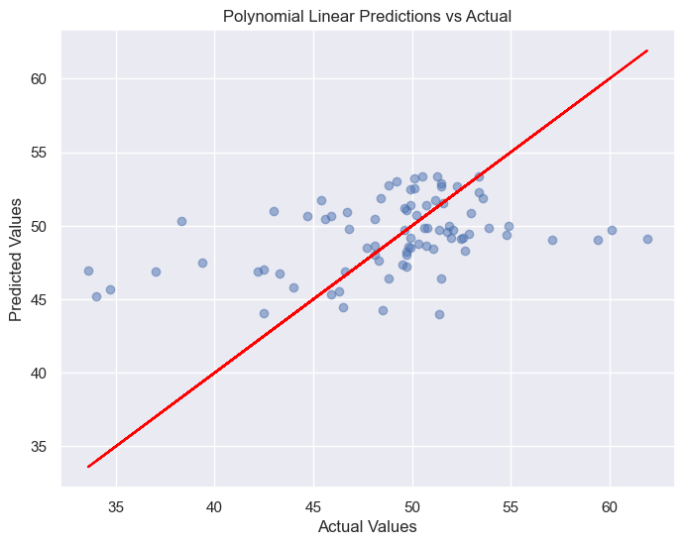
Predicting ratio of bikes added
Polynomial Linear Regression:
Mean Absolute Error: 3.48
Mean Squared Error: 22.51
Root Mean Squared Error: 4.74
R-squared: 0.14
6
Notes:
Let me just quickly show you, by contrast, a model that was far less effective – polynomial linear regression. It does correctly identify most of the stations that are losing bikes, but the predictions are way to close to 50% and you can see that all the predictions are in this horizontal arrangement, meaning that it’s predicting very similar values for large groups of stations.

Slide 17
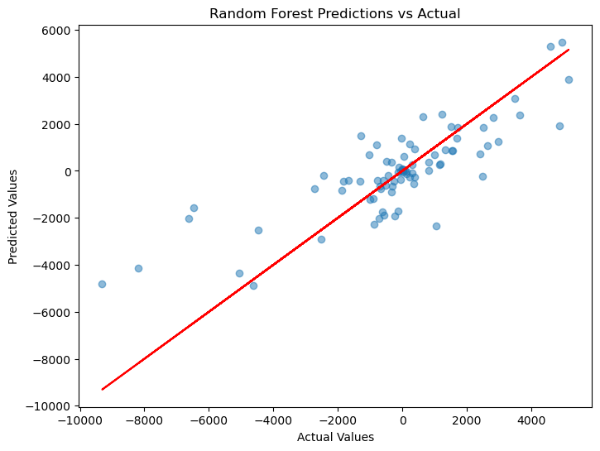
Predicting net total bikes taken/returned
Random Forest:
Mean Absolute Error: 1032
Mean Squared Error: 2.2m
Root Mean Squared Error: 1495
R-squared: 0.66
6
Notes:
Now we look at the measure that’s a little more difficult to predict, namely the net total of bikes taken and returned. Why is the scale so large? Because it covers the whole 2.5 year period of the data set. [Stats]
We have an r-squared value of 0.66, and we could express this in another way: roughly two thirds of the variation we observe in the net total of bikes taken and returned can be explained by the independent variables in the model, namely the latitude and longitude of the station.

Slide 18
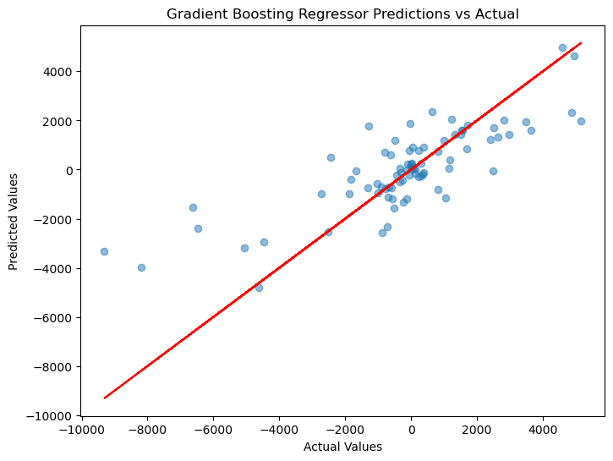
Predicting net total bikes taken/returned
Gradient Boosting Regressor:
Mean Absolute Error: 1044
Mean Squared Error: 2.5m
Root Mean Squared Error: 1571
R-squared: 0.62
6
Notes:
Quite a similar result. But, when I changed the random state on the train/test split, the gradient boosting regressor performed less consistently. This suggests that gradient boosting regressor is overfitting to the specific data it’s trained on, whereas the random forest model maintains higher scores across different splits.

Slide 19

05
Challenges

Slide 20
How does ML contribute to KPIs?
1) Reduce station downtime
2) Increase Bike Angel rides
Prediction of station (im)balance helps to plan rebalancing measures.
Bike Angel program could target users living in critical areas (e.g. high elevation).
Predictions of (im)balance can improve targeting of Bike Angel rewards
13
Notes:
Station downtime is defined as the length of time per month that a station is completely full or empty.
If we can already predict whether a new station or an existing station is going to remain in balance due to normal user activity or consistently lose or gain bikes over time, this helps Capital Bikeshare and the operator Motivate to plan its rebalancing measures more effectively. As you will recall, these include bike coralls for receiving bikes at busy stations and the transport of bikes by truck from full to empty stations.
Bike Angels example: If we know that a certain station tends to lose bikes throughout the day, we can incentivise Bike Angels to replenish that station with bikes as soon as it has several open docks.

Slide 21

06
Key Takeaways

Slide 22
Key Takeaways
Random forest
Elevation
Human eye
Recommended model
Accuracy might be improved with elevation data
Does ML actually tell us anything we can’t see with our own eyes?
16
Notes:
Random forest performed most consistently when predicting the ratio and the net total.
We used latitude and longitude as data to feed the model, but perhaps we could improve accuracy if we also knew the elevation above sea level of each station.
[Read human eye] – The kind of trends we’re talking about – for instance, that people are more likely to ride downhill – are already quite easily visible by marking the most imbalanced stations on a map of the city. I would suggest that right now the ML is of limited use, except for confirming what we can already observe from the data. However, if we add other independent variables to the training data in the future, perhaps the ML approach will reveal something we could not spot with our own eyes.

Slide 23
Thanks
Any more questions?
paul@sabinwords.com
Please keep this slide for attribution

